Slide 1
Effects of hitech
Adoption
  Eligible hospital (Acute) – 3.2% to 14.2%
  Ineligible hospital (LTC, Psych, Rehab) - 0.1% to 3.3%
Productivity – discharges by DRG / OP visits by MDC
    Up ~250% (Kim & Lee) – based on hospital revenue and ONLY IT labor
    (US Bureau of Labor Statistics) based on all labor costs
      Flat from 2010 to 2019
      Down 1.6% from 2019 to 2022 (Covid)
        OP services down 12%; IP services (elective surgeries) down 4.6%

Slide 2
Effects of hitech
Quality (Lin)
  Systems must be used properly
  Clinical workflows must be supported / improved
    Help understand problem (results)
    Plan action (instructions to patient, drugs that can be used)
    Monitoring (vital signs)
    Decision making
    Coordinating (orders quicker, medications easier to obtain)
  Removal of financial barriers
    Smaller hospitals show better quality increases

Slide 3
Effects of hitech
Quality (Atasoy, Greenwood, McCullough, 2019)
  56% of articles unambiguously positive results
  21% positive, but mixed
  Specific quality improvement examples
    Decreases dosage errors (automated dosage calculators reduced by ~50%) – Terrell, et al, 2010
    Increases risk assessment (cardiovascular disease) – Wells, et al, 2008
    Decreases prescription errors compared with CPOE (4.8%) compared to handwritten (6.7%) – Shulman, et al, 2005
    PHRs increase screening compliance in some studies – why?
    Breakout groups –
      What could be some reasons why some HCOs see quality benefits and others do not?
      What are some possible limitations of studies showing positive quality effects?

Slide 4
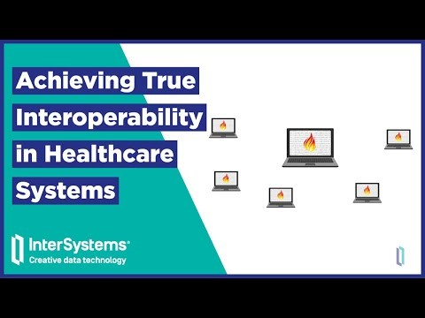
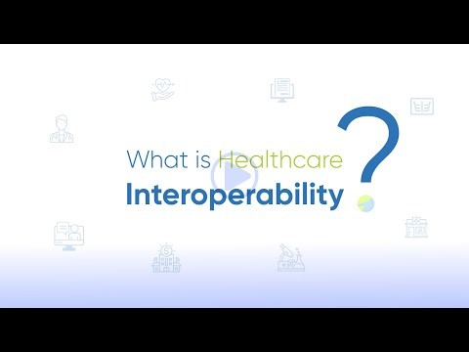
Effects of hitech
Interoperability

Slide 5
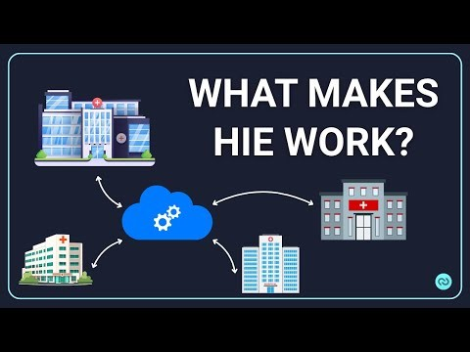
Effects of hitech
Health Information Exchanges
  Slow progress – providers worried about losing patients, Vendors “locking-in” customers

Slide 6
Effects of hitech
Financial
  Not shown to reduce costs unless HCO has access to sufficient IT labor resources
  Some studies show improved coding for higher reimbursement

